Slide 1
Determining My Cultural Identity
Student’s Name
Institutional Affiliation

Slide 2
Co-cultures Research Section
I belong to African and Jewish traditional co-cultures.
The two co-cultures give me a sense of belonging.
My dad is an African while my mum is a Jew.
Having a blend of the two has helped shaped the person l am today.
The interaction with people from other cultures has been made easier due to the impact of the co-cultures.

Slide 3
Co-cultures Research Section
The African culture is authentic and original
Lewis and Oscar (9-25) explain that the Jewish culture is conservative.
The two cultures have a lot of significance with rich heritage.
They have managed to blend with the dominant culture for peaceful co-existence.

Slide 4
My Family’s Ethnic Roots
African ancestors came from Kenya, an African country.
Jewish ancestors came from Germany.
Migration from Africa for quality healthcare, employment opportunities
Migrated from Germany during the second world war
Moved to look for entrepreneurial opportunities

Slide 5
My Family’s Ethnic Roots
The Jews wanted to trade.
To establish raw materials for manufacturing sector.
Lewis and Oscar (9-25) agree that America seemed a better place for growth and quality education.
Culture shock was a huge problem with multiple negative stereotyping.

Slide 6
My Family’s Culturally Shared Traditions/Beliefs/Etc
They valued communal living and association
They celebrated all the rites of passages
Solomon and Andrew (52-60) indicate that Ceremonies and rituals were conducted during the time.
They lived together in clans or groups with a common ancestral
Men were believed to be naturally born as leaders

Slide 7
My Family’s Culturally Shared Traditions/Beliefs/Etc
Women were never given opportunities to lead.
There was division of labor and specialization.
They valued life as was considered sacred
The dead were treated with so much respect
Members of the society mourn when death occurs

Slide 8
My Family’s Culturally Shared Traditions/Beliefs/Etc
Solomon and Andrew (52-60) agree that Both cultures valued and carried out circumcision of boys
These cultures are individualistic
Members are overprotective of what they believe in

Slide 9
My Family’s Cultural Value Patterns and Value Orientation Patterns
My family advocates for respect, love an appreciation of culture
Listening is mostly encouraged
Questioning is allowed to ensure mutual understanding among those conversing
No culture is superior over the other
Negative stereotyping is not acceptable in the family

Slide 10
My Family’s Cultural Value Patterns and Value Orientation Patterns
Making judgement without learning the reasons behind the actions is discouraged
We are one and culture should not divide us
Our differences should be our pride, our strength
Always focus on the positivity only
No one is perfect.

Slide 11
My Family’s Cultural Value Patterns and Value Orientation Patterns
Take the good lesson from each culture for us to be complete
Always appreciate your culture with that of the others.

Slide 12
Synthesis of Your Cultural Identity
The integration of the two co-cultures has made me who I am
The family patterns an orientation have shaped how I relate with others.
The combination of all the information obtained has enlightened me
I am proud of who I am and can never be intimidated

Slide 13
Synthesis of Your Cultural Identity
My culture, my heritage, my pride
I have understood why I behave the way l do
I am not ashamed of whom I am nor my roots

Slide 14
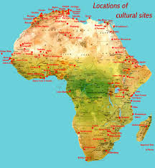
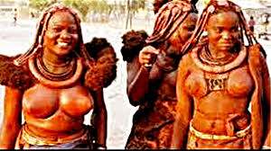
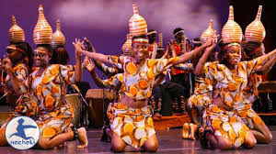
Visual Elements
African culture

Slide 15
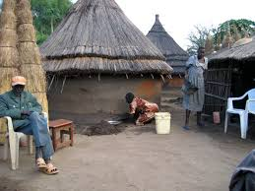
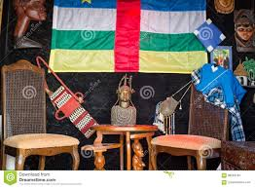
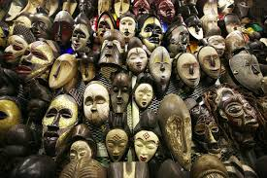
Visual Elements
African culture

Slide 16
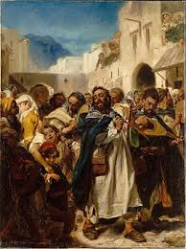
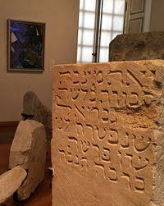
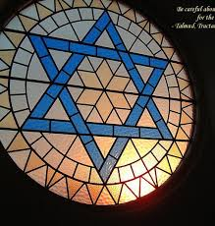
VISUAL ELEMENTS
Jewish culture

Slide 17
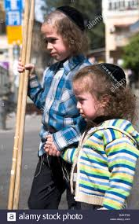
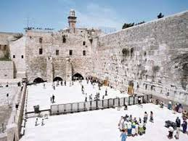
VISUAL ELEMENTS
Jewish culture

Slide 18
Work Cited
Lewis, Oscar. "The culture of poverty." Poor Jews. Routledge, 2017. 9-25.
Hobson, Janell. Venus in the dark: Blackness and beauty in popular culture. Routledge, 2018.
Bozeman, Adda B. Politics and culture in international history: from the ancient Near East to the opening of the modern age. Routledge, 2017.
Solomon, Andrew. "Far from the tree." Unknowable, Unspeakable, and Unsprung. Routledge, 2016. 52-60.
Ro'i, Yaacov. Jews and Jewish life in Russia and the Soviet Union. Routledge, 2016.

